Slide 1

UNIT-I
LEXICAL ANALYSIS
SCS1303 Compiler Design

Slide 2
UNIT 1 LEXICAL ANALYSIS
Structure of compiler
Functions and Roles of lexical phase
Input buffering
Representation of tokens using regular expression
Properties of regular expression
Finite Automata
Regular Expression to Finite Automata
NFA to Minimized DFA.
SCS1303 Compiler Design

Slide 3
Outline
Finite Automata
  Non-Deterministic Finite Automata(NFA)
  Deterministic Finite Automata(DFA)
  Conversion of Regular Expression to NFA(Thompson’s Construction)
  Conversion of NFA to DFA(Subset Construction Method)
  Conversion of DFA to Minimized DFA
Assignments
SCS1303 Compiler Design

Slide 4
What is Finite Automata?
A recognizer for a language is a program that takes as input a string x and answers “yes” if x is a sentence of the language and “no” otherwise.
Finite automata: a generalized transition diagram to compile regular expression into a recognizer.
A machine that accepts Regular Language.
Applications:
  Compliers
  Text processing
  Hardware design
SCS1303 Compiler Design

Slide 5
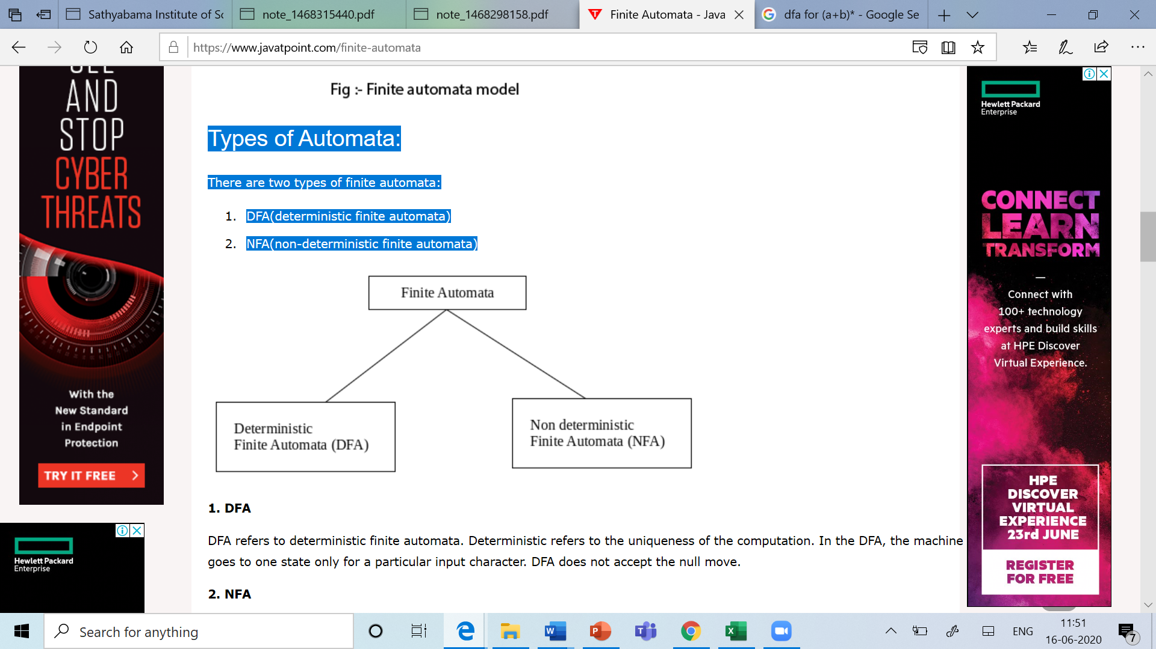
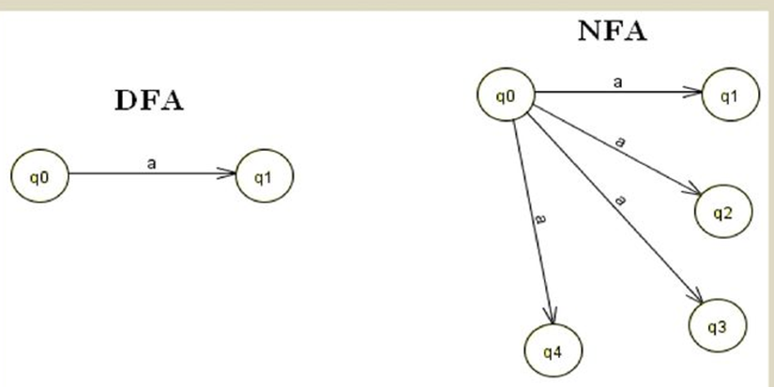
Types of Automata
SCS1303 Compiler Design

Slide 6
Finite Automata
Both DFA and NFA are capable of recognizing the regular sets.(what a regular expression denote.)
Time-space Trade-off:
  DFA can lead to fast recognizers than NFA.
  DFA can be much larger than an equivalent NFA.
SCS1303 Compiler Design

Slide 7
Non-Deterministic Finite Automata
NFA is a mathematical model that consists of:
  a set of states s
  a set of input symbols ∑ (input symbol alphabet)
  a transition function move that maps state-symbol pairs to set of states
  a state s₀ that is distinguished as the start or initial state
  a set of states F distinguished as accepting or final states.
  An NFA can be represented diagrammatically by a labelled directed graph called a transition graph.
  The nodes are states and the labelled edges represent the transition function.
  This graph looks like a transition diagram, but the same character can label two or more transitions out of one state.
  Edges can be labelled by the special symbol ε .
SCS1303 Compiler Design

Slide 8
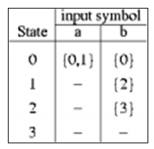
NFA-Example
the set of states of the NFA is {0,1,2,3}
the input symbol alphabet is {a,b}
state 0 is start state
The accepting state 3 is indicated by double circle.
NFA for (a|b)*abb
a
start
a
b
b
0
1
2
3
Transition Table
b
SCS1303 Compiler Design

Slide 9
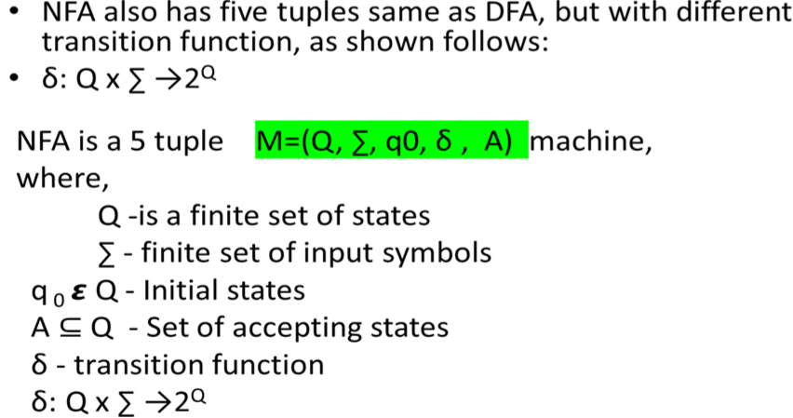
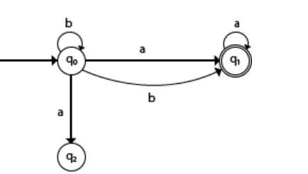
Formal definition of NFA
SCS1303 Compiler Design

Slide 10
DFA (Deterministic Finite Automata)
DFA is a special case of NFA in which:
  for each state s and input symbol a ,there is at most one edge labeled a leaving s.
    i.e. only one path for specific input symbol from the current state to the next state.
  no state has an ε-transition i.e. a transition on input a .
Each entry in the transition table of a DFA is a single state.
SCS1303 Compiler Design

Slide 11
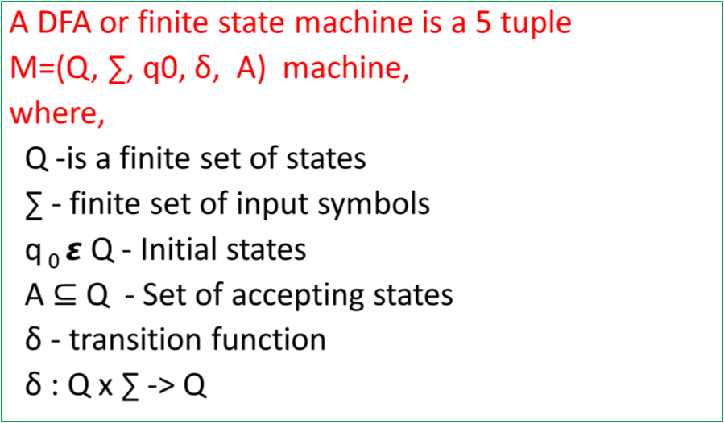
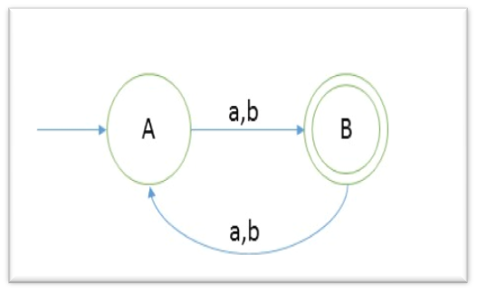
Formal Definition of DFA
SCS1303 Compiler Design

Slide 12
DFA vs. NFA
DFA | NFA
DFA can be understood as one machine. | Multiple small machines computing at the same time.
Difficult to construct - Complex structure. | Easier to construct.
Rejects the string if not terminated at the accepting state. | Rejects only after multiple checks.
Less execution time on input string. | More execution time.
All DFA are derived from NFA. | Not all NFA are DFA.
DFA requires more space. | Requires less Space.
The next possible state is clearly set. | Ambiguity occurs.
SCS1303 Compiler Design

Slide 13
Finite Automata Notations
A state
Start State
Accepting State
A transition
label
SCS1303 Compiler Design

Slide 14
Conversion Process
Regular Expression
NFA
DFA
Minimized DFA
Thompson’s Construction Method
SCS1303 Compiler Design

Slide 15
Regular Expressions to NFA
(Thompson’s Construction Method)
For each kind of RE, define an NFA.
Input: A Regular Expression r over an alphabet ∑
Output: An NFA N accepting L(r)
Method:
Step 1: For ε
The NFA recognizes {ε}
Step 2: For a in ∑
The NFA recognizes {a}
start
ε
i
f
start
a
i
f
SCS1303 Compiler Design

Slide 16
Thompson’s Construction Method
Step 3: RE=a |b
The NFA recognizes {a,b}
Step 4: RE=ab
OR
The NFA recognizes {ab}
a
1
2
ε
ε
start
0
5
ε
ε
3
4
b
start
a
b
start
a
ε
b
0
1
2
0
1
2
3
SCS1303 Compiler Design

Slide 17
Thompson’s Construction Method
Step 5: RE=a*
The NFA recognizes {ε,a,aa,aaa,.......}
Step 6: RE= a⁺
= a.a*
Follow step 4 for construction.
ε
start
ε
a
ε
0
1
2
3
ε
SCS1303 Compiler Design

Slide 18
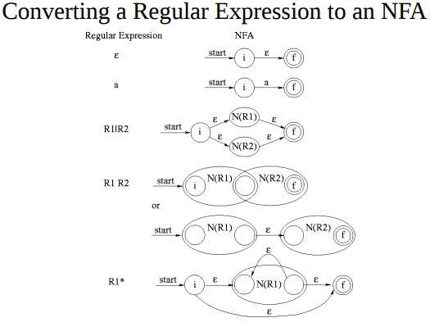
SCS1303 Compiler Design

Slide 19
Problem 1
Construct Non deterministic Finite Automata for the following regular expression using Thompson’s Construction method.
  (a|b)*abb
  (a|b)*
  (a*|b*)*
  ((ε|a)b*)*
  (0|123)*
SCS1303 Compiler Design

Slide 20
Example 1
Decomposition of (a|b)*abb
r₁₁
start
a
0
1
r₉
r₁₀
start
b
r₇
2
3
r₈
r₅
b
a
r₆
b
1
2
r₄
*
ε
ε
a
start
(
r₃
)
0
5
r₁
r₂
ε
ε
|
3
4
b
a
b
SCS1303 Compiler Design

Slide 21
Example 1(contd.)
Decomposition of (a|b)*abb
r₁₁
r₉
ε
r₁₀
r₇
a
r₈
2
3
r₅
b
ε
start
ε
ε
r₆
b
0
1
ε
r₄
*
6
7
a
ε
ε
(
)
4
5
r₃
b
r₁
|
r₂
ε
a
b
SCS1303 Compiler Design

Slide 22
Example 1(contd.)
Decomposition of (a|b)*abb
r₁₁
r₉
ε
r₁₀
r₇
a
r₈
2
3
r₅
b
ε
start
ε
ε
a
r₆
b
0
1
ε
r₄
*
6
7
8
a
ε
ε
(
)
4
5
r₃
b
r₁
|
r₂
ε
a
b
SCS1303 Compiler Design

Slide 23

NFA for (a|b)*abb
ε
a
2
3
ε
ε
start
0
ε
1
ε
a
b
b
6
7
8
9
10
ε
ε
4
5
b
ε
SCS1303 Compiler Design

Slide 24
Assignment
Construct Non deterministic Finite Automata for the following regular expression using Thompson’s Construction method.
  (a|b)*abb
  (a|b)*
  aa*|bb*
  ((ε|a)b*)*
  (0|123)*
SCS1303 Compiler Design

Slide 25
THANK YOU
SCS1303 Compiler Design

